Slide 1
Quantum Espresso : pw.x
2025 제6회 전자구조계산 여름학교
GIST
Dongbin Shin

Slide 2
Install QE (module mpi, compiler, mkl, ase)
mkdir install
cd install
wget https://gitlab.com/QEF/q-e/-/archive/qe-7.4/q-e-qe-7.4.tar
tar -xvf q-e-qe-7.4.tar
cd q-e-qe-7.4
./configure
make pw pp
cd ~
git clone https://github.com/yhkimlab/ESCSchool.git
cp E (+ tap)
cp ESCSCHOOL/install_qe7.4.sh ./
sh install_qe7.4.sh
Install ase
pip install --upgrade git+https://gitlab.com/ase/ase.git@master

Slide 3
Install QE (module mpi, compiler, mkl, ase)
cd ~
git clone https://github.com/yhkimlab/ESCSchool.git
----여기까지 되어있음-----
cd ~
cp ESCSCHOOL/install_qe7.4.sh ./
sh install_qe7.4.sh
Install ase
pip install --upgrade git+https://gitlab.com/ase/ase.git@master

Slide 4
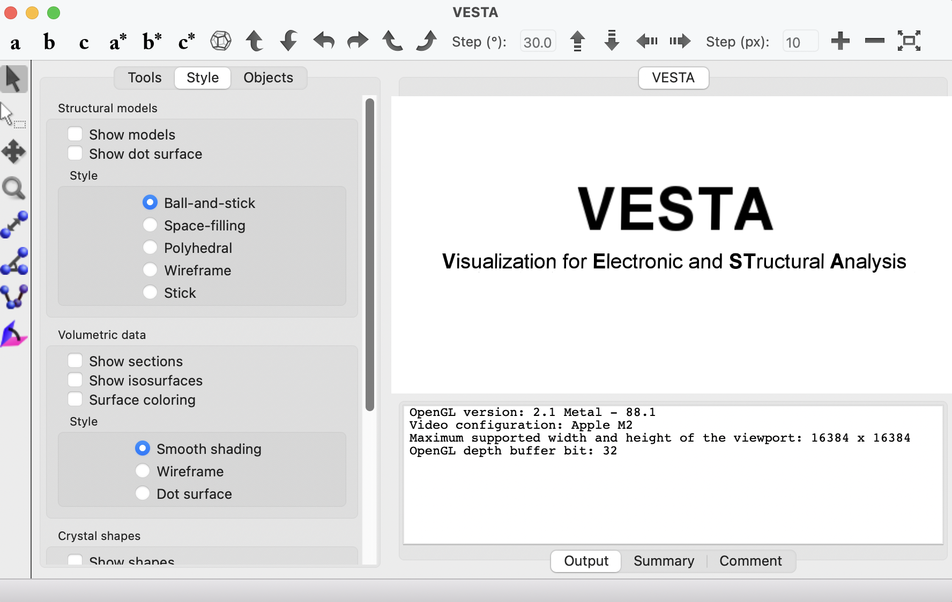
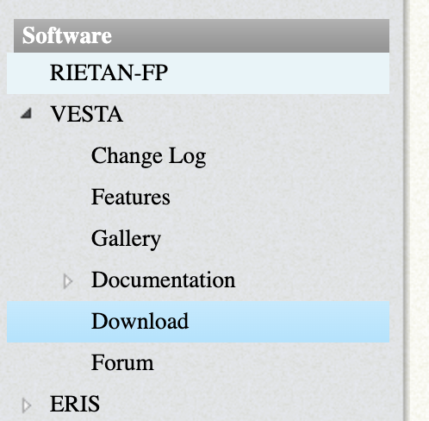
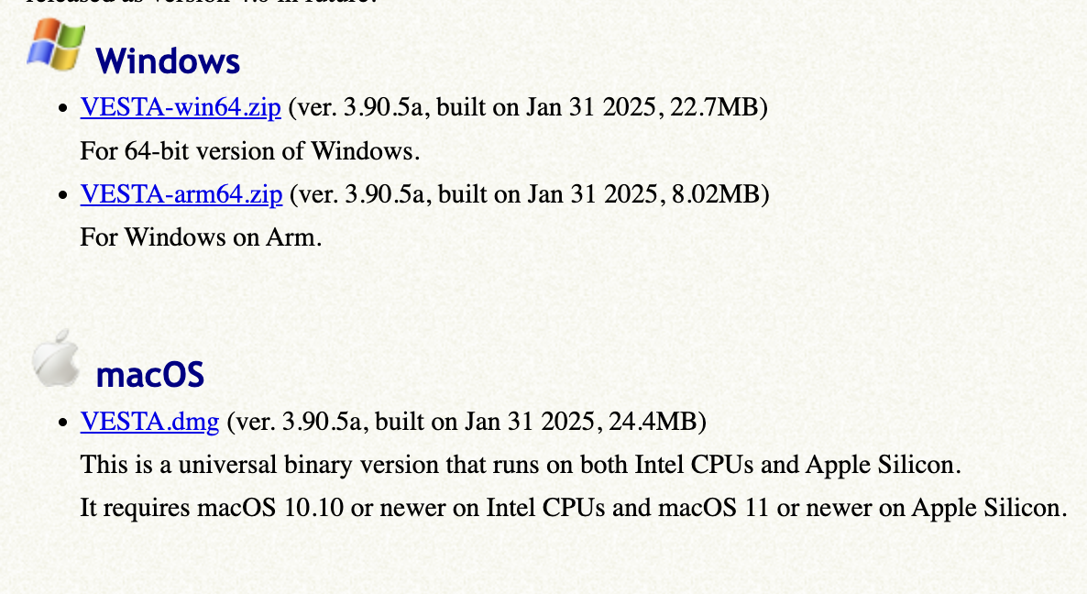
VESTA 설치
https://jp-minerals.org/vesta/en/

Slide 5
Exersice: summer_tuto.f90

Slide 6
Install summer_tuoto.f90
cp ESCSchool/exercise_shin/lecture2/pw_check/* ~/install/q-e-qe-7.4/PP/src
cd ~/install/q-e-qe-7.4/PP/src
make

Slide 7
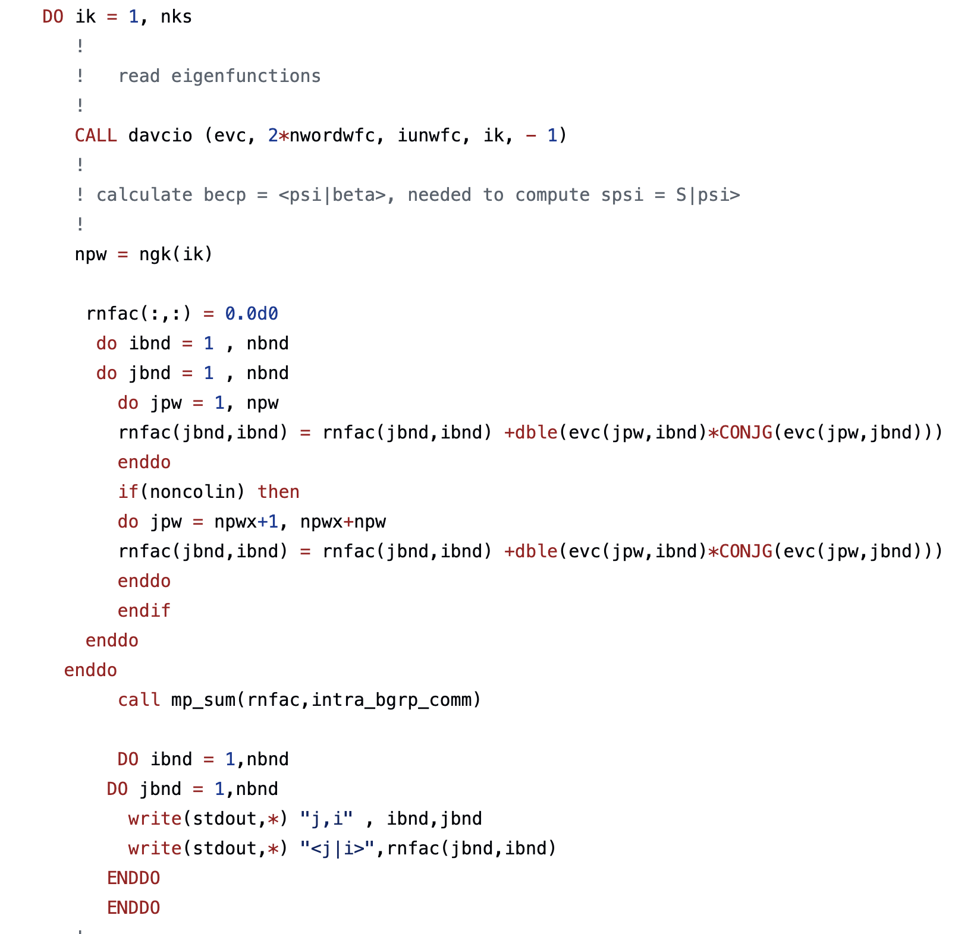
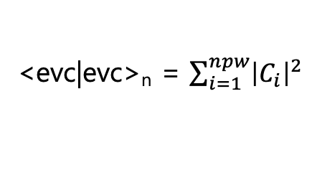
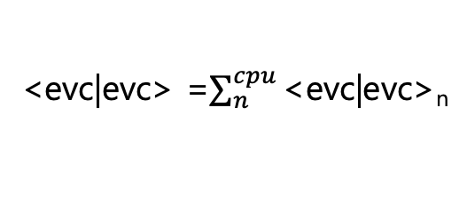
Check the Normalization
Call the wavefunction and save it in evc(1:npw,1:nbnd)
<evc|evc>_{n} = $\sum_{i=1}^{npw}{{\left|C_{i}\right|}^{2}}$
<evc|evc> =$\sum_{n}^{cpu}{\text{<}\text{evc}\text{|}\text{evc}\text{>}\text{n}}$

Slide 8
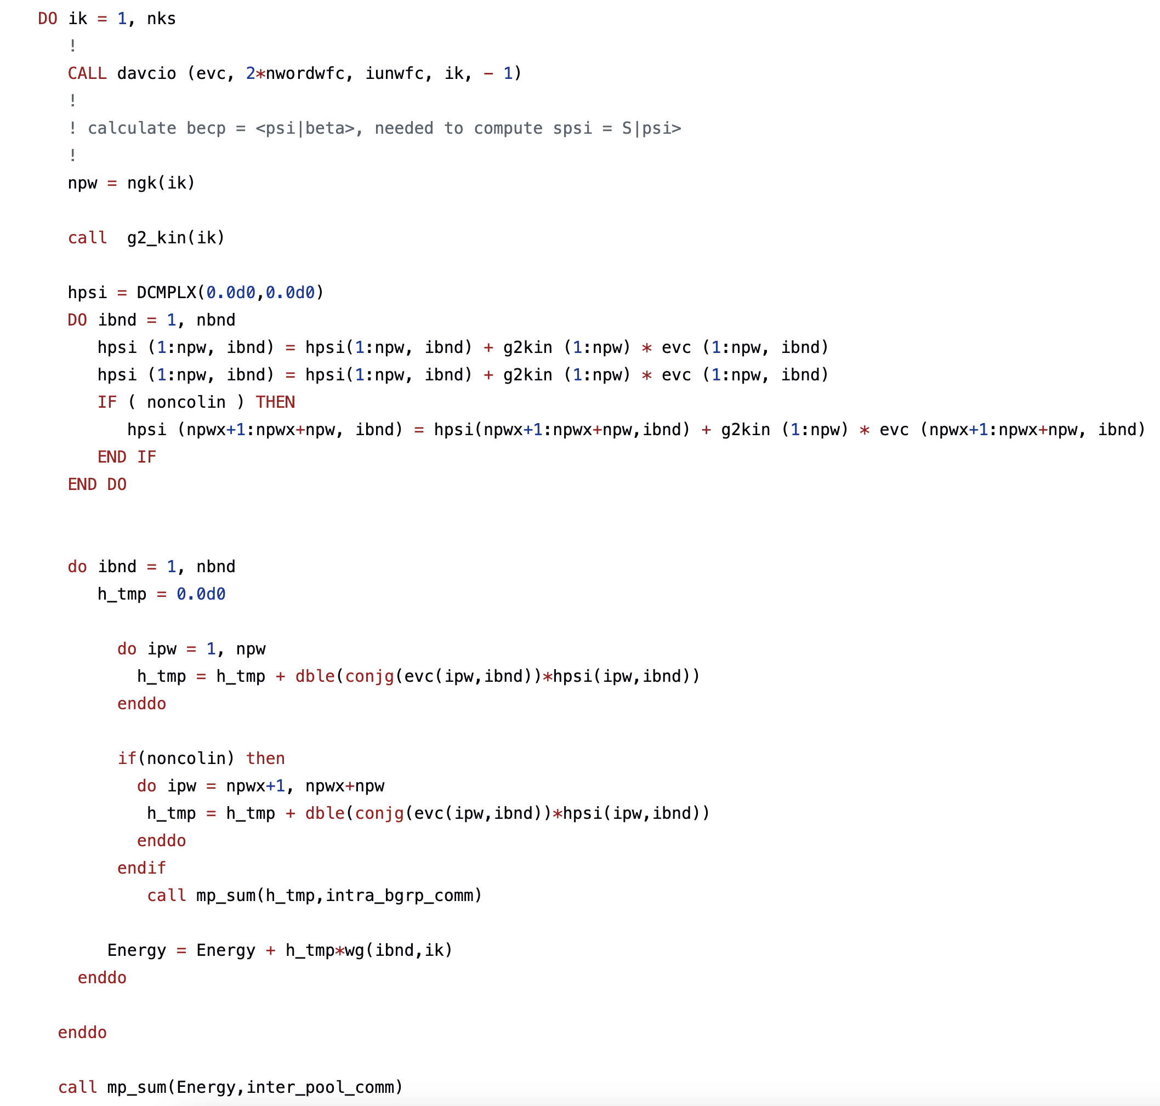
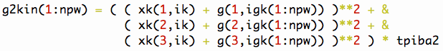
Check the Kinetic energy

Slide 9
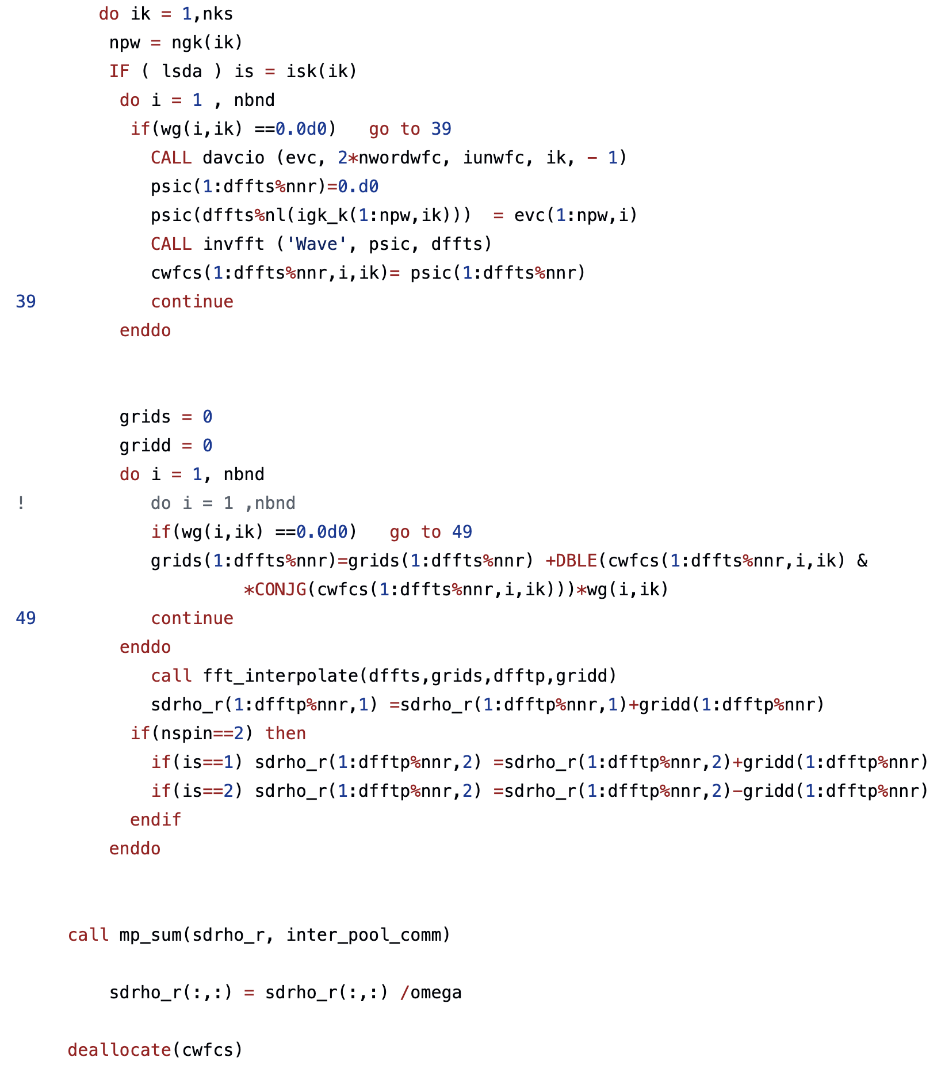
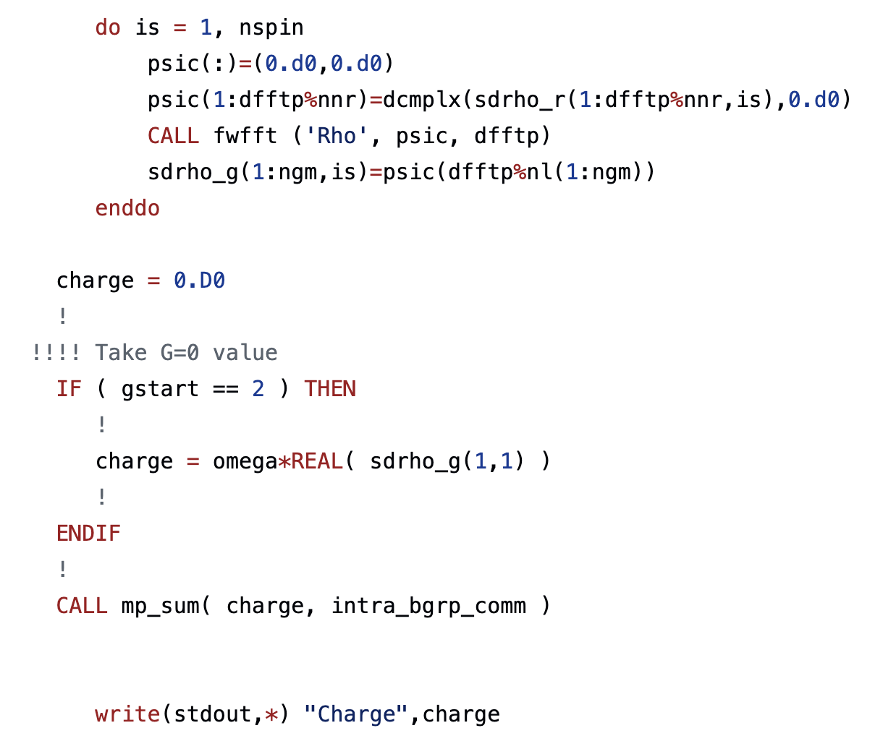
Evaluate the charge density

Slide 10
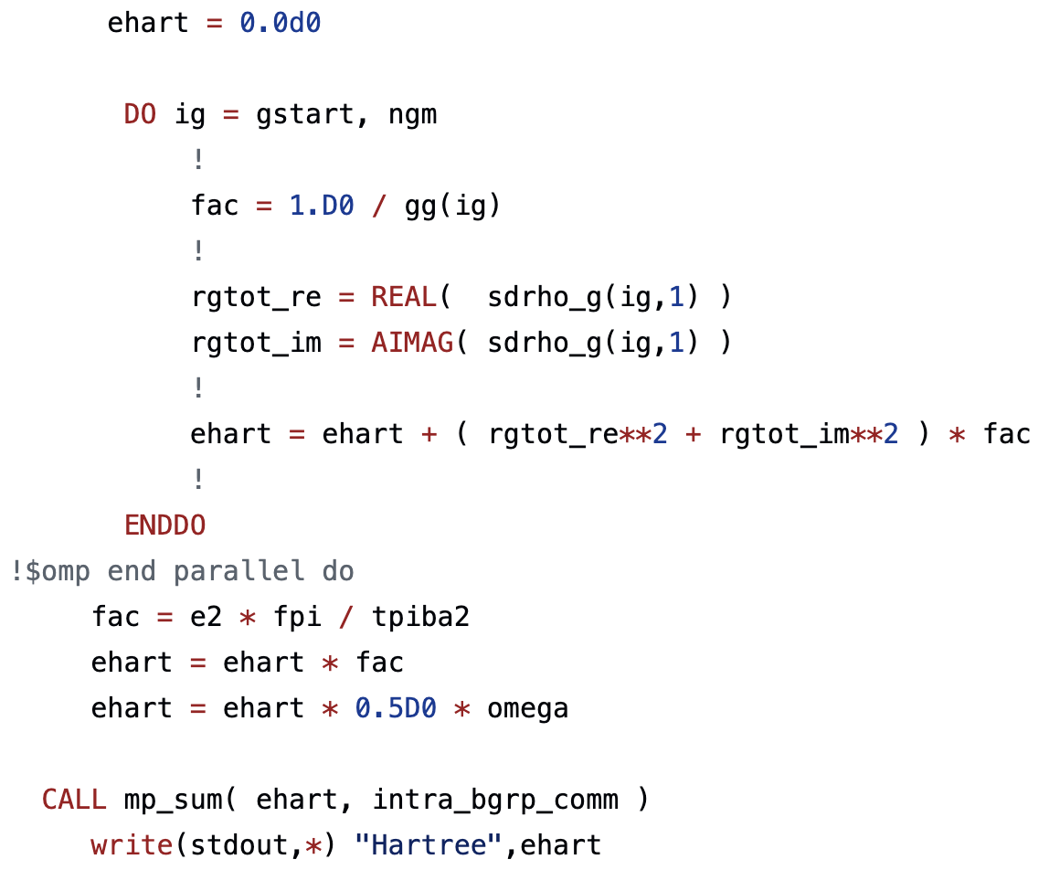
Evaluate the Hatree energy

Slide 11
SCF in Pw.x

Slide 12
Structure of pw.x
pwscf.f90
read_input.f90
read_namelist.f90
read_card.f90
read_pseudo.f90
input.f90
recvec_sub.f90
Read input & Preparing
electrons.f90
g2_kin.f90
forces.f90
vloc_of_g.f90
set_local.f90
stress.f90
v_of_rho.f90
functionals.f90
move_ions.f90
set_vrs.f90
Calculate Kohn-Sham eq
Making potential
c_band.f90

Slide 13
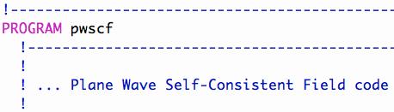
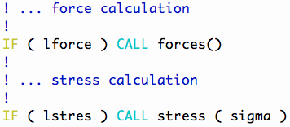
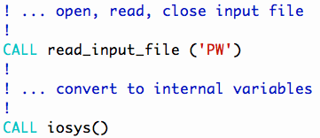
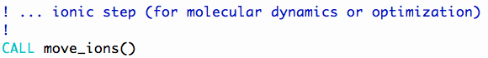
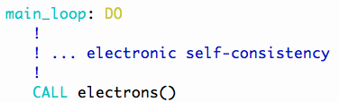
pwscf.f90
pw.x main loop

Slide 14
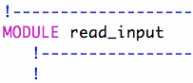
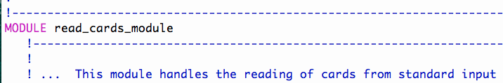
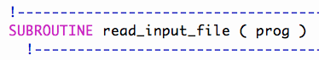
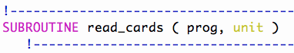
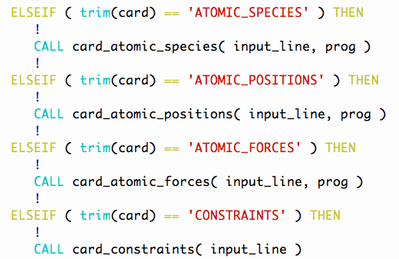
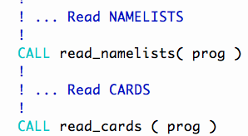
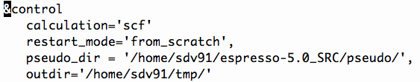
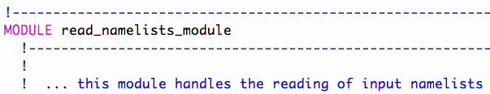
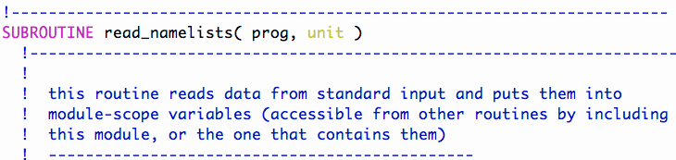
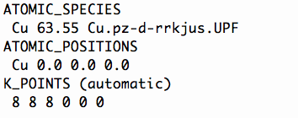
read_input.f90
Read input file
namelists
cards

Slide 15
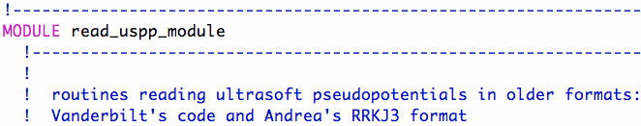
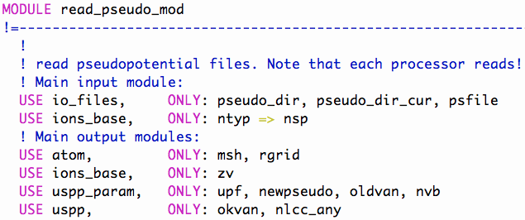
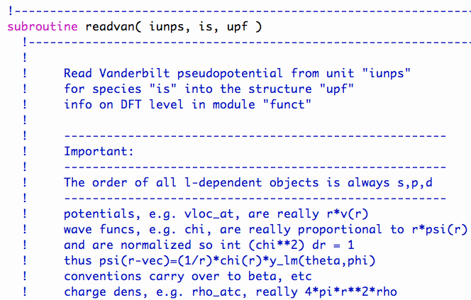
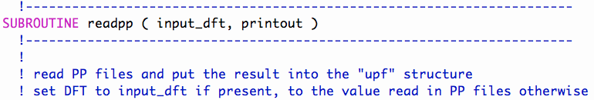
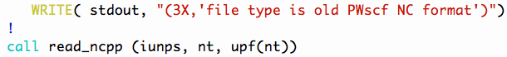
read_pseudo.f90
read_uspp.f90
Read pseudopotential file

Slide 16
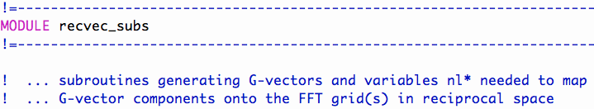
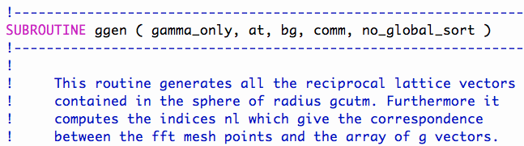
recvec_sub.f90
Generating G vectors

Slide 17
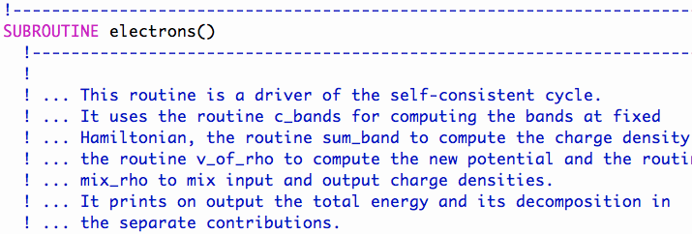
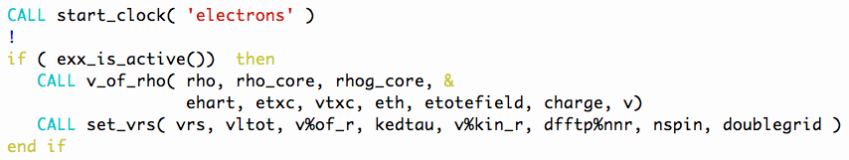
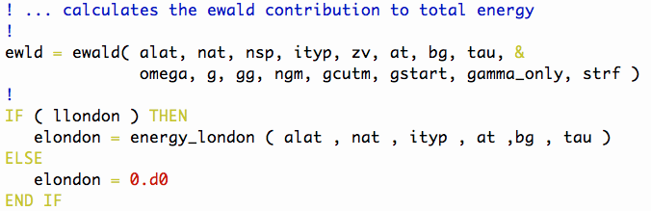
electrons.f90
SCF cycle

Slide 18
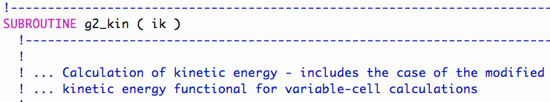
Kinetic energy – T
g2_kin.f90
ik : k-point index
xk : bloch vector
g : g-vector
tpiba2 : (2π/a)²
npw : number of g vector
igk : g vector corresponding index
1. G space calculation
2. Preparing g² values for each G and k
3. Output is laplacian of wave functions.

Slide 19
Pseudopotential – V_{PP}

Slide 20
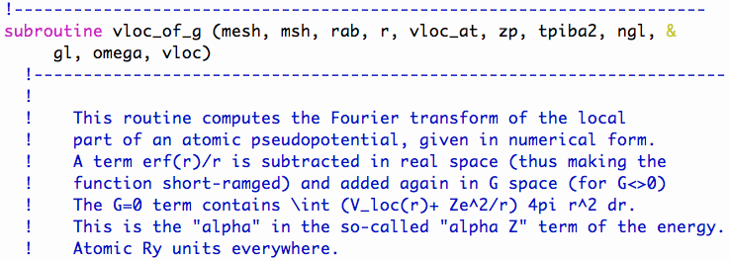
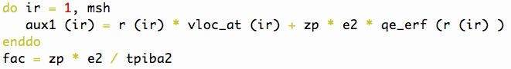
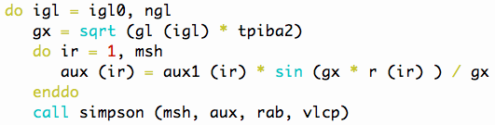
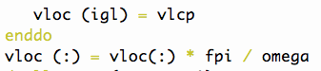
Local part of pseudopotential – V_{PP}^{L}
vloc_of g.f90
1. G space calculation
2. Calculate local part of PP at r grid
3. Calculate integral gird component
4. Integral (simpson) for each G vector
ir : Radial grid
aux1 : Local PP of r grid
aux : Integral grid component
vloc_at : local part of atomic PP
tpiba2 : (2π/a)²
zp : valence pseudo charge
vloc : local potential
gx*r
aux1(ir)

Slide 21
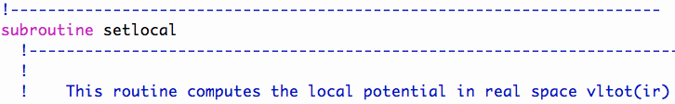
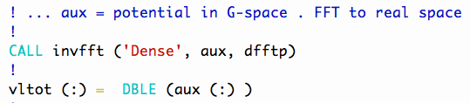
Local part of pseudopotential – V_{PP}^{L}
setlocal.f90
1. G space calculation
2. Multiply structure factor for each G and atom type
3. Output potential in real space
strf
We calculated it at previous code.

Slide 22
Potential of charge density – V(ρ)
v_of_rho.f90
Potential of charge density
- After kohn sham SCF, charge density will be updated.
- Potential of charge density should be updated for next SCF calculation.

Slide 23
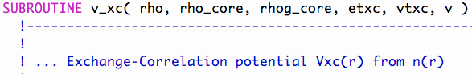
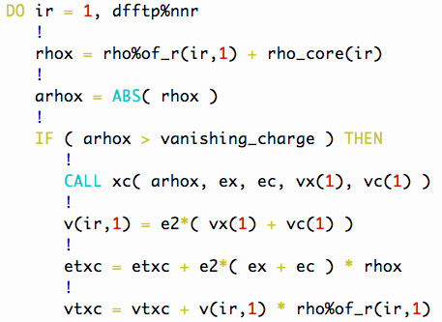
Exchange Correlation Potential – V_{xc}[ρ]
v_of_rho.f90
rhox : total charge in each point
arhox : absolute value of the charge in each point
ex : local exchange energy
ec : local correlation energy
vx : local exchange potential
vc : local correlation potential
1. Real space calculation
2. Sum each grid
3. Output : v, etxc, vtxc
v
etxc
vtxc

Slide 24
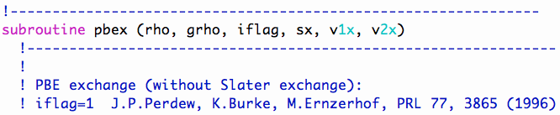
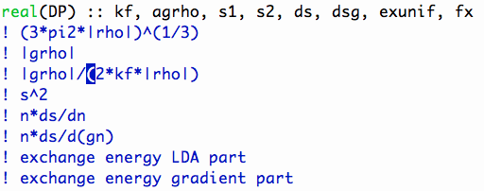
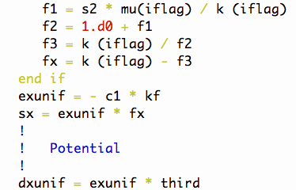
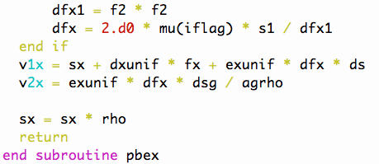
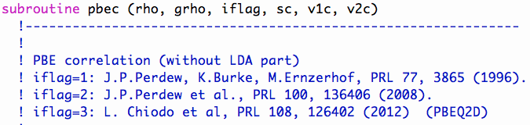
Exchange Correlation Potential – PBE
functional.f90
rho : Total charge at one point
grho : Gradient of total charge at one point
agrho : Absolute value of grho
sx : Exchange energy at one point
ec : local correlation energy
v1x & v2x : exchange potential

Slide 25




Hartree Potential – V_{H}(r)
v_of_rho.f90
rhog : Charge density in G space
ehart : Hartree energy
gg : Inner product of g vector
fpi : 4π, tpiba2 : (2π/a)²
vx : local exchange potential
vc : local correlation potential
rgtot
gg
1. G space calculation
2. Calculate Hartree energy & potential
3. FFT ( G to R ) Hartree potential
4. Sum XC and Hatree potential in R space
5. Output : ehart, v

Slide 26
Structure of pw.x
pwscf.f90
g2_kin.f90
read_input.f90
Making initial potential
v_of_rho.f90
input.f90
electrons.f90
c_band.f90
rotate_wfc.f90
vloc_psi.f90
forces.f90
h_psi.f90
cal_bec.f90
stress.f90
cdiaghg.f90
add_vuspsi.f90
move_ions.f90
Solve Kohn-Sham eq

Slide 27


electrons.f90
SCF cycle
g2_kin.f90
rotate_wfc.f90
v_of_rho.f90
electrons.f90
c_band.f90
h_psi.f90
cdiaghg.f90
SCF Do loop
1. After calculate local potentials
2. In c_bands, KS eq. will be set and solve

Slide 28


Complex Hamiltonian diagonlization
c_band_k.f90
h_diag : Kinetic matrix
1. Make kinetic matrix
2. Make H-psi matrix
3. Diagonaliztion

Slide 29



Rotation of wavefunction
rotate_wfc_k.f90
- Rotate by H
1. h_psi for H-psi
2. cdiaghg for diagonalization

Slide 30



H psi– HΨ
h_psi.f90
1. Calculate V local – psi matrix in G space
2. Add non-local term (uspp)

Slide 31




vloc psi– VΨ
vloc_psi.f90
1. Potentials are saved in R space
2. Multiply potential and psi in R space
3. Save Vpsi in G space

Slide 32


US pseudo potential
add_vuspsi.f90

Slide 33



Calculates eigen values and vectors
cdiaghg.f90
ZHEGV : diagonalization (LAPACK)
1. Do diagonalization

Slide 34



electrons.f90
Calculate Total energy
Descf : scf correction
Demet : smearing contribution
En_el : electric field contribution
Ehart : hartree contribution

Slide 35


electrons.f90
SCF cycle
1. After each SCF step is done
2. Mix the charge density

Slide 36
pwscf.f90
pw.x main loop
1. Calculate forces
2. Calculate stress
3. Move ions

Slide 37



forces.f90
stress.f90
Forces and stress

Slide 38
Structure of pw.x
Construct V_ext
Guess rho_in
Pwscf.f90
- Initiate calculation : input.f90
- Construct V_ext : input.f90
electrons.f90
- Compute V_KS : v_of_rho.f90
- Diagonalize H_KS : cband.f90, sum_ bands.f90 h_psi.f90
- Mix to get new rho_in : mix_rho.f90
- forces, stress and atom move : forces.f90, stress.f90 and move_ions.f90
Compute V_KS
Diagonalize H_KS
Mix to get new rho_in
Compute rho_out
Rho_in = rho_out
no
yes
Comput forces, stress and other properties

Slide 39

Flowchart of TDDFT
2
1
1. Charge density mix : mix_rho.f90
2. Charge convergence : rho_ddot
3. Ions move and velocity
3

Slide 40





mix_rho.f90
Mix rho

Slide 41


rho_ddot
Density convergence

Slide 42





Dynamics_module.f90
Molecular dynamics

